Slide 1
Automated Halal Product Identification through Ingredient Analysis
7th Grade
By Rasyidah, DSIF-SG-11

Slide 2
Table of contents
01
02
03
04
Introduction
Problem Statement
Objective
Data
Workflow, Data Collection, Data Processing
Using OpenAI,
Fine Tuning
Feature Engineering
Conclusion
Final Thoughts
Future Developement

Slide 3
01
Introduction

Slide 4
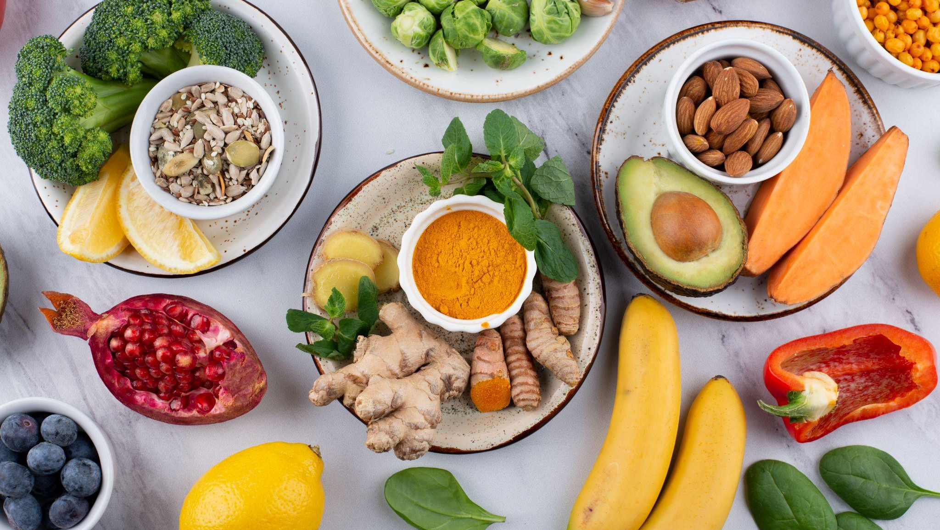
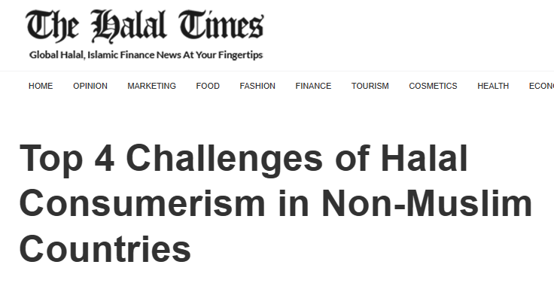
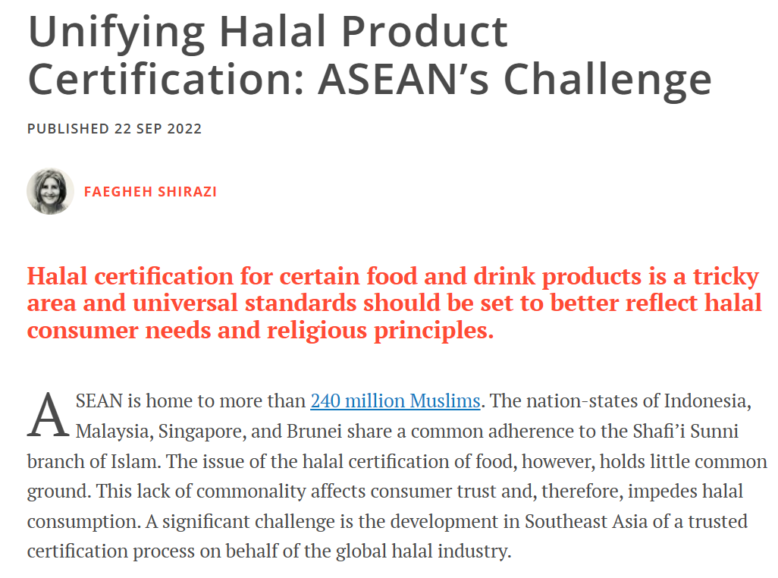
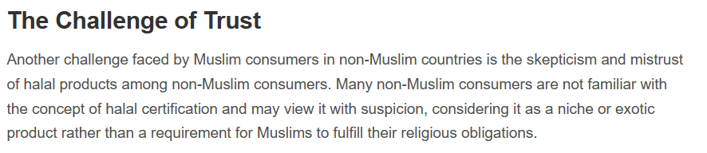
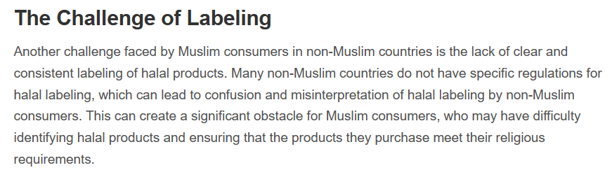
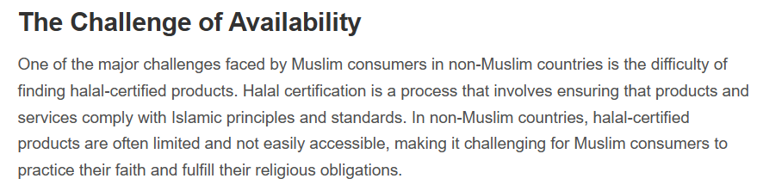
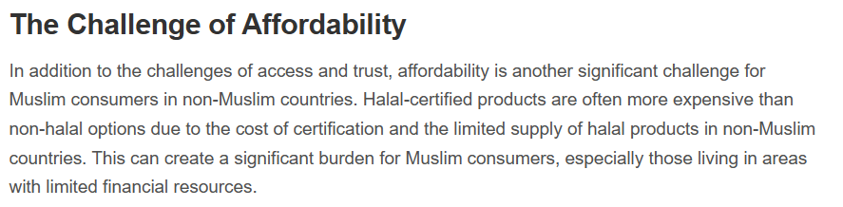

Slide 5
Problem Statement
Develop an automated system to determine whether food products are halal or not by analyzing and interpreting their ingredients, particularly when purchasing products overseas.

Slide 6
Objectives
Create a model to classify food as halal, non-halal or doubtful
Ingredients not in database will be checked through OpenAI
Accessible Information
Enhancing the ability of consumers, especially Muslims, to make informed choices when purchasing food items abroad.

Slide 7
Success Metrics
Answer Relevancy
Measures how relevant the generated answer is to the question
Faithfulness
Measures how accurate the generated answer, hallucinated or factuality

Slide 8
Data
02
Workflow, Data Collection, Data Processing

Slide 9
Data Sources
MUIS Website | Food and Drink Categories | Food Selection | Food Preparation | Food Additive Listing
World of Islam | Food Additive List
Islamcan.com | Halal Haram Database

Slide 10
Project Workflow
Halal Status Check
Backend Processing
Data Collection on Ingredients
Text Extraction
Image Capture
Fine tuning
Handling Unknown Ingredients
Notes:
Data Collection on Ingredients - Collect and compile data on halal, non-halal, and doubtful ingredients.
Image Capture - Capture images of products and their ingredient labels.
Text Extraction - Implement text detection on images to identify and print the list of ingredients.
Handling Unknown Ingredients - ingredients not found in compiled list is processed through Open AI model to determine if they are halal’
Halal Status Check - Compare the ingredients extracted from images against the pre-compiled list.
Backend Processing - Perform backend processing to enhance the accuracy and efficiency of the system.
Fine tuning - Fine-tune the chat model to improve interaction and response quality regarding halal ingredient queries.

Slide 11
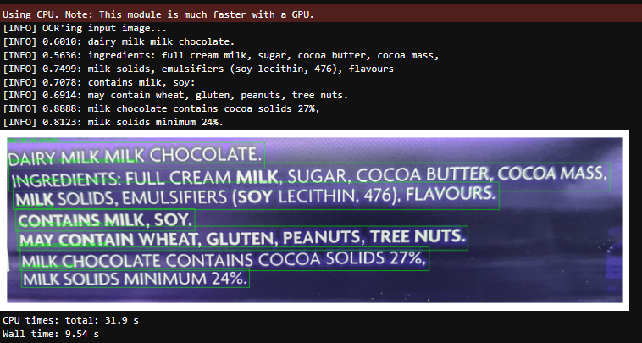
Ingredients are detected correctly

Slide 12
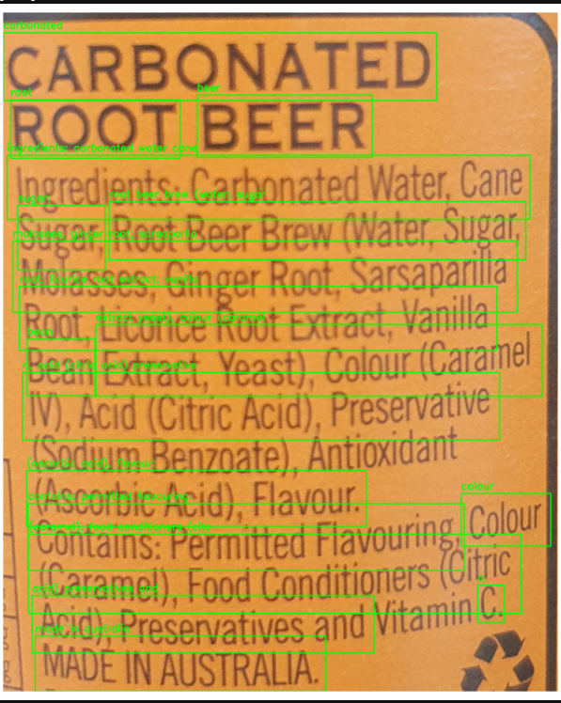
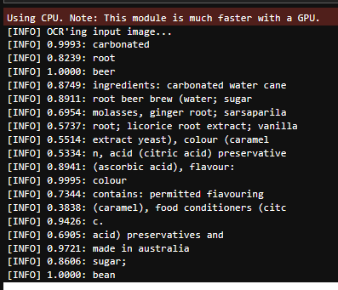
Easy OCR
Ingredients text poorly detected

Slide 13
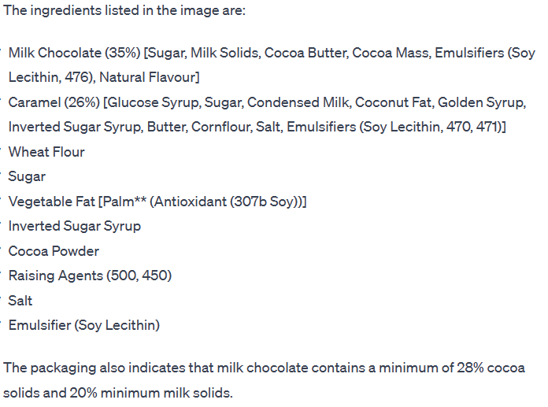
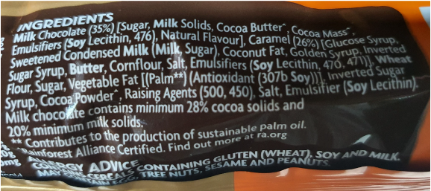
GPT-4 Vision
preview
Images are passed through the model via url or the base64 encoded image

Slide 14
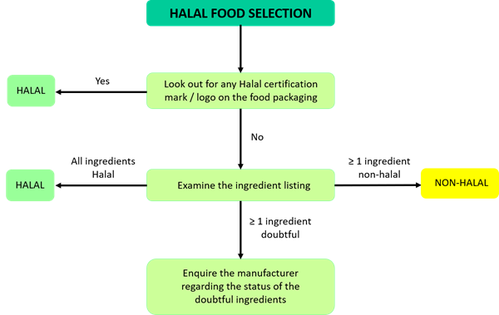
Halal Food Selection

Slide 15
03
Feature Engineering
GPT Open Ai Model

Slide 16
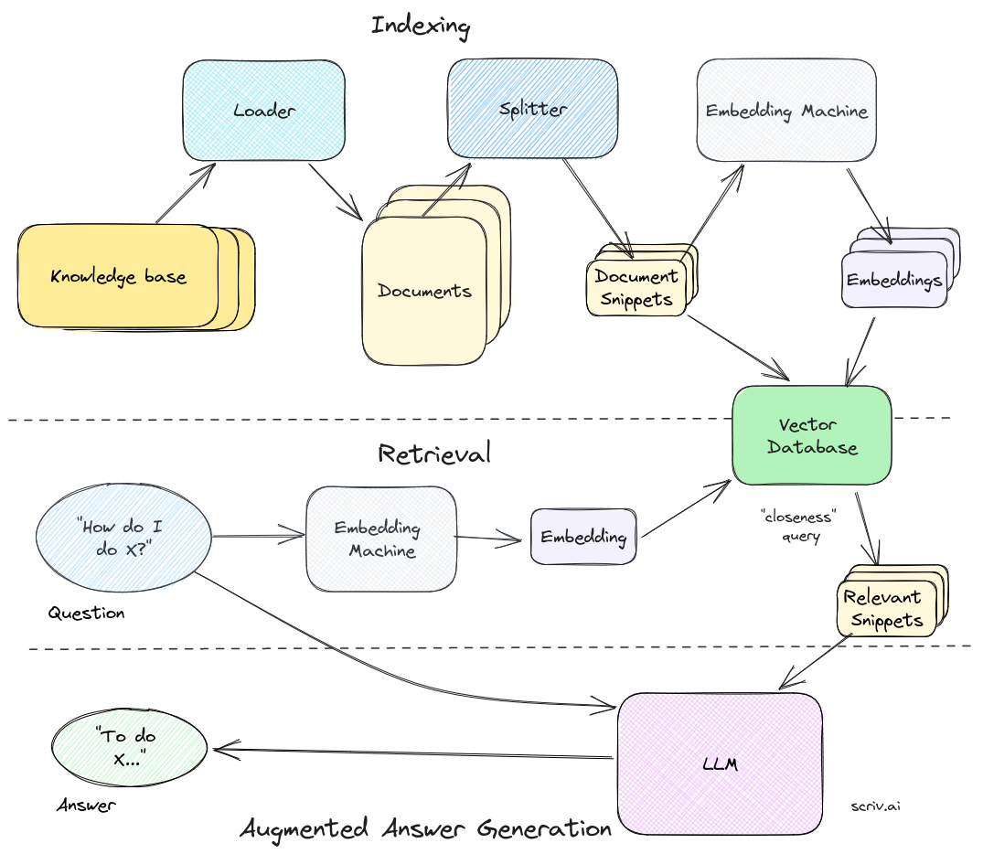
Retrieval- Augmented Generation
(RAG) pipeline
How do domain-specific chatbots work? An Overview of Retrieval Augmented Generation (RAG) | Scriv

Slide 17
General Task Overview
question_gen_query = (
"Given your expertise in Halal food certification, I need you to analyze the ingredients of a specific food product for Halal compliance. Please provide a clear and detailed assessment for each ingredient based on the information available in the provided documents. Consider factors such as the source and processing methods of each ingredient, as these can impact its Halal status. If any ingredient is non-Halal, doubtful, or lacks sufficient information for assessment, please categorize the entire food product accordingly. Your goal is to determine the overall Halal status of the food product. Please provide concise and factually accurate responses."
)

Slide 18
Detailed Task Instruction
Question_gen_query = "As an expert in halal food certification, your task is to meticulously analyze the ingredients of food products. "
"A user is looking to determine if a specific food product is halal. "
"For each ingredient listed in a product, provide a detailed assessment based on the information available in the uploaded documents. "
"Some ingredients may have different halal statuses depending on their sources or processing methods. "
"Evaluate each ingredient to determine if it is halal, non-halal, or doubtful. "
"Consider the source and processing of each ingredient, as this can influence its halal status. "
"Your goal is to ensure that each ingredient in the product is halal. If any ingredient is non-halal, doubtful, not identifiable, or lacks sufficient information to ascertain its halal status, then the entire food product should be considered non-halal. "
"Provide a conclusive assessment for each ingredient, thereby determining the overall halal status of the food product."

Slide 19
Success Metrics
Prompts | Models | Answer Relevancy | Faithfulness
General | ft:gpt-3.5-turbo-1106 | 0.969 | 0.8
General | gpt-3.5-turbo-0613 | 0.9591 | 0.75
Task Oriented | gpt-3.5-turbo-0613 | 0.944 | 0.6
Task (CSV,pdfhtm) | gpt-3.5-turbo-0613 | 0.961 | 0.55

Slide 20
04
Conclusion

Slide 21
Conclusion
Effective in Simple Ingredient Detection:
performs efficiently in identifying basic ingredients,
demonstrating its effectiveness in simpler scenarios of ingredient analysis.
Optimal Model Performance:
Gpt-3.5-turbo-1106
Formulation of prompts, a pivotal role in influencing model performance

Slide 22
Future Developments
Streamlining Phrase Recognition for removal
Detailed Analysis of Sub-Ingredients
Enhancing the Precision of Halal Status Determination
Ongoing Model Improvement
Incorporating User Feedback

Slide 23
—Someone Famous
“This is a quote, words full of wisdom that someone important said and can make the reader get inspired”

Slide 24
Thanks!
Please keep this slide for attribution

Slide 25
Q & A

Slide 26
References
Here’s an assortment of alternative resources whose style fits that of this template:
Vectors:
Top 4 Challenges of Halal Consumerism in Non-Muslim Countries - The Halal Times
Unifying Halal Product Certification: ASEAN’s Challenge | FULCRUM
Halal consumerism from a wider perspective (nst.com.my)

